Slide 1

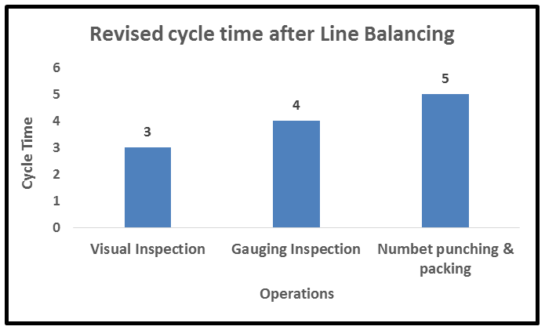
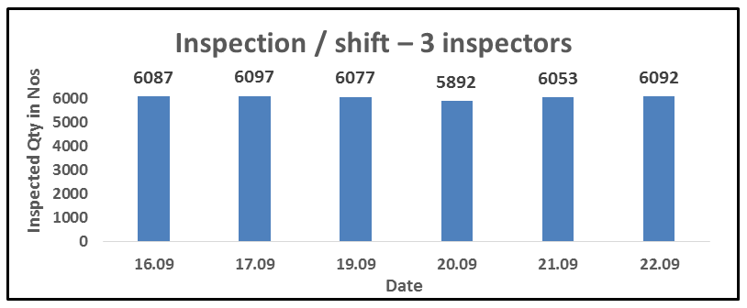
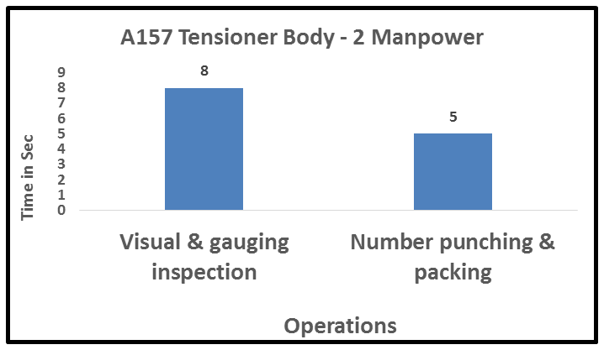
P15
TPM CIRCLE NO :- 01
ACTIVITY
KK
QM
PM
JH
SHE
OT
DM
E&T
KAIZEN IDEA SHEET
TPM CIRCLE NAME:
LOSS NO. / STEP
DEPT :- ASSEMBLY
RESULT AREA
P
Q
A
C
D
S
M
CELL:-Tensioner
CELL NAME:- CKD
MACHINE / STAGE :- inspection
OPERATION :- Assly.
KAIZEN THEME : To Reduce waiting time
IDEA :-Line balancing by splitting inspection activity in 2 parts
Problem present status :-line not balanced 3 sec waiting time by part no. punching stage
COUNTERMEASURE:-
1)
BENCHMARK
TARGET
85%OEE
KAIZEN START
20.08.2016
TDC
22.09.2016
TEAM MEMBERS Shrikant Kulkarni ,
monika ,vijay :
KAIZEN FINISH
22.09.2016
BENEFITS :-
Save manpower ,work load balance , increase productivity
Before
After
KAIZEN SUSTENANCE
WHY - WHY ANALYSIS :-
Why1 :- work load in not equally divided .
Why2 :- cycle time not balanced
Why3 :- part no . punching operator waiting
RESULT :-
WHAT TO DO:-..
HOW TO DO:-
FREQUENCY :-
ROOT CAUSE : Line not balanced 3sec waiting time
REGISTRATION NO. & DATE :- 08.10.16
SCOPE & PLAN FOR HORIZONTAL DEPLOYMENT
REGISTERED BY :-Shrikant Kulkarni
SR.
NO.
CELL
TARGET
RESPONSIBILITY
STATUS
MANAGER’S SIGN :-Janardan sate
1
A394
23.09.16
Nitin Sutar
Completed

