Slide 1
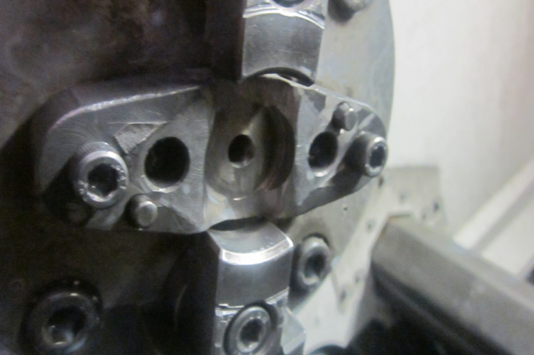
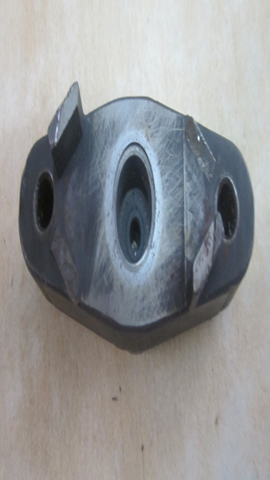
P15
TPM CIRCLE NO :- 01
ACTIVITY
KK
QM
PM
JH
SHE
OT
DM
E&T
KAIZEN IDEA SHEET
TPM CIRCLE NAME: Achiever
LOSS NO. / STEP
DEPT :- MACHINE SHOP
RESULT AREA
P
Q
A
C
D
S
M
CELL:- A215
CELL NAME:- TENSIONER
MACHINE / STAGE :- Machining
OPERATION :- Tensioner
KAIZEN THEME : To avoid m6 Tap Broken on CNC tensioner
IDEA :- Pull down chuck job locator counter bore to be provided
Problem present status- Frequently M6 tap broken
COUNTERMEASURE:-
1.Counter bore of 10mm provided
BENCHMARK
50/month
TARGET
0
KAIZEN START
10.03.2016
TDC
15.03.2016
KAIZEN FINISH
TEAM MEMBERS : 1.santosh,amol,Walunj,sachin chaudhari
,pawar sir
BENEFITS :-
Tap broken stop due to stuck
Tapping oversize problem killed
After
KAIZEN SUSTENANCE
WHY - WHY ANALYSIS :-
Why1 :- Tap broken on cnc
why2:- while tap tap dash to locator
Why3 :- no counter depth provided
Why4 :-
RESULT :- TAP BROKEN /TAPPING ATTACHMENT BROKEN ZERO
WHAT TO DO.check point added in setter checklist
HOW TO DO:-.
FREQUENCY :-
ROOT CAUSE :- Locator centre counter id not provided
REGISTRATION NO. & DATE : 23.02.2016
SCOPE & PLAN FOR HORIZONTAL DEPLOYMENT
REGISTERED BY :-walunj.
SR.
NO.
CELL
TARGET
RESPONSIBILITY
STATUS
MANAGER’S SIGN :- Santosh wakchaure
1
Not Applicable

