Slide 1
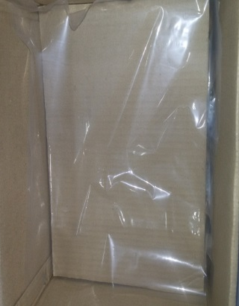
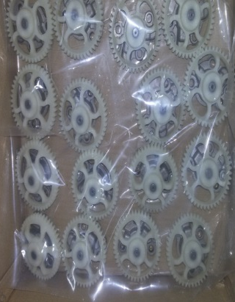
P15
TPM CIRCLE NO :- 01
ACTIVITY
KK
QM
PM
JH
SHE
OT
DM
E&T
KAIZEN IDEA SHEET
TPM CIRCLE NAME: Oil Pump
LOSS NO. / STEP
DEPT :- QA
RESULT AREA
P
Q
A
C
D
S
M
B
CELL :-A106
CELL NAME:- Oil Pump
MACHINE / STAGE :- Packing
OPERATION :-Packing
KAIZEN THEME : To avoid rusty jobs
IDEA :-To avoid contact of job with corrugated partition.
COUNTERMEASURE:-
BENCHMARK
500 nos.
Problem present status :- Job found rusty in box paccking at dispatch
TARGET
0
KAIZEN START
10.6.16
KAIZEN FINISH
10.6.16
TEAM MEMBERS : Meraj Sayyed ,
Sandhya Chavan , Jagat, Bhavesh
BENEFITS :-
No customer complaint
Polysheet provided on separator as well as on top of job to avoid contact
Job gets rusty after coming in contact with box separator
Before
After
KAIZEN SUSTENANCE
WHY - WHY ANALYSIS :-
Why1 : Job found rusty in box packing at dispatch
Why2:-Job gets in contact with corrugated separator
Why3 :-No provision to avoid contact at current stage.
RESULT :-
1. Rework Cost = Rs.27,000. saved
WHAT TO DO: NA
HOW TO DO: NA
FREQUENCY –NA
SCOPE & PLAN FOR HORIZONTAL DEPLOYMENT
Sr No | CELL | TDC | RESP. | STATUS
1 | A206 | 8.11.16 |  | Completed
2. | A260 | 8.11.16 |  | Completed
ROOT CAUSE : No provision to avoid contact of job with corrugated separator
REGISTRATION NO. & DATE : 10 .11.16
REGISTERED BY :-
MANAGER’S SIGN :-

